Slide 1
Service Bus & Enterprise Integration Pack
Dan Toomey | Mexia
@daniel2me

Slide 2
Why is integration more important now than ever?
Digital transformation
App is king
Data is everywhere
Everything is connected
Integration is the backbone
Notes:
Businesses are seen as being innovative
IT is seen as catching up to innovation
3 components: proliferation of apps, data as management nightmare, smart devices that need to interact

Slide 3
Integration at the center of digital transformation
c
75%
70%
1/2 the cost
of large organizations will establish a hybrid integration platform, by 2020
of the cost of a mobile app project is concerned with integration
of implementing IoT solutions will be spent integrating the various IoT components with each other and the back-end systems, through 2018
Source: Gartner “Market Guide for Hybrid Integration Platform-Enabling Technologies,” by Elizabeth Golluscio, Jess Thompson, Keith Guttridge, April 25, 2016
Notes:
Recent gartner report on hybrid integration platform:
By 2020 75% of organizations will establish a hybrid integration platform
70% of mobile app project is going to be concerned with integration
50% of cost of implementing an IoT solution will be spent on integration

Slide 4

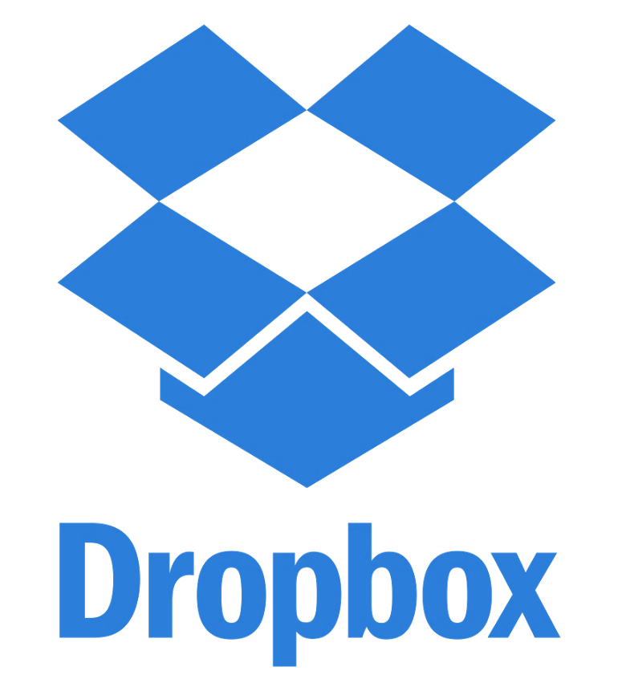


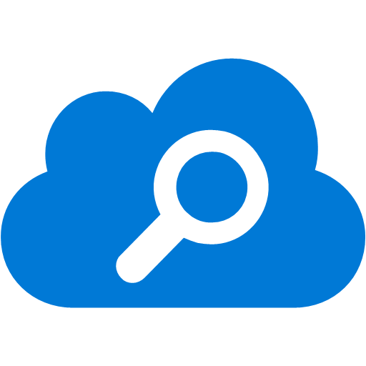

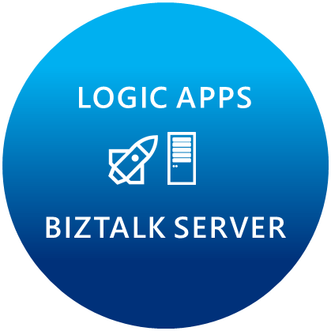
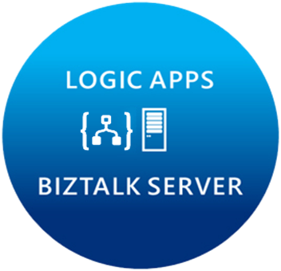









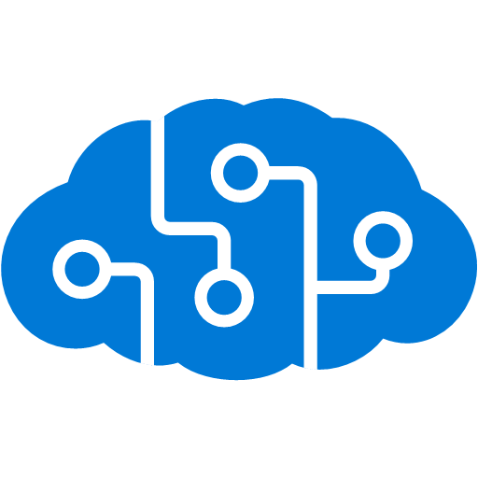


Microsoft’s Hybrid Integration Platform
LOGIC APPS
BIZTALK SERVER
About 39% of developers are focused on building cloud based Application integration
API MANAGEMENT
AZURE SERVICE BUS
IoT/Event Hub
Azure Search
SQL Database
CONNECTORS
AZURE SERVICES
AZURE SERVICE BUS
DocDB
BLOB Storage
Functions
API MANAGMENT
Machine Learning
HD Insight
Site Recovery
B2B/EDI
Tables
Cognitive Services
DNS
Notes:
Its not just about the products, we have a pool of out-of-the-box connectors that help connect to many SaaS applications.
Secret sauce is really the Azure services.
Azure is now at your fingertips – opens doors to numerous possibilities.
Traditional integration vendors, ask customers to build silo-ed integration solutions.
That approach is not going to allow you to scale to your customer needs.
With Azure, you can build holistic solutions.
I can do more than integration – once you have your connected system, you can perform analytics on the data using HD insight, machine learning, to gain insight on your data.
This is going to help customers make great business decisions.
Some of you have IoT practices today, this is how you can leverage integration and IoT together.
At MSFT, we think that there are multiple points of entry into integration: Think about your customers who reach out to you about mobile development, about IoT solutions, any e-commerce applications, eventually they are going to need a solid integration platform – and that’s what MSFT offers.
2 key differentiating factors to highlight again:
Hybrid 2. Azure Services

Slide 5
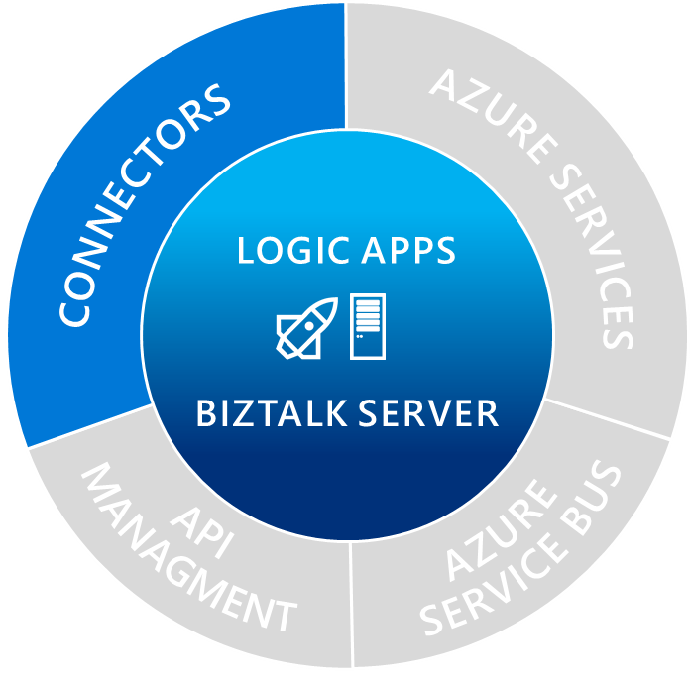
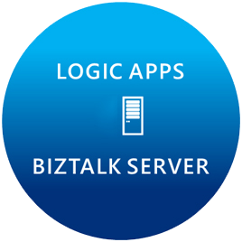

Managed connectors
Cloud APIs and platform functionality
Dozens of built-in connectors
Hosted and managed within the platform
Scales to meet your needs
First class designer experience
Rapid development
API connections
Authenticate once and reuse
Differentiate connection configuration
Simple to deploy
Portal experience for managing API Connections

Slide 6
Spectrum of connectors
SaaS
Protocols/Native
appFigures
Asana
Azure API Management
Azure App Services
Azure Automation
Azure Cognitive Face API
Azure Cognitive LUIS
Azure Cognitive Text Analytics
Azure Data Lake Store
Azure Document DB
Azure Functions
Azure Machine Learning
Azure Resource Manager
Azure Service Bus
Azure SQL
Azure Storage Blob
Azure Storage Queues
Basecamp
Bing Search
BitBucket
Bitly
Blogger
Box
Buffer
Campfire
Chatter
Common Data Service
Disqus
DocuSign
Dropbox
Dynamics AX Online
Dynamics CRM Online
Dynamics CRM Service Bus
Dynamics Financials
Dynamics Operations
Easy Redmine
Eventbrite
Facebook
Freshdesk
GitHub
Gmail
Google Calendar
Google Contacts
Google Drive
Google Sheets
Google Tasks
GoTo Meeting
GoTo Training
GoTo Webinar
Harvest
HelloSign
Infusionsoft
JIRA
Insightly
Instagram
Instapaper
MailChimp
Mandrill
Medium
Microsoft Project Online
Microsoft Translator
MSN Weather
Office 365
Office 365 Users
Office 365 Video
OneDrive
OneDrive for Business
OneNote
Outlook.com
Outlook Tasks
PagerDuty
Pinterest
Pipedrive
Power BI
Project Online
Redmine
Salesforce
Salesforce Chatter
SendGrid
SharePoint Online
Slack
SmartSheet
SparkPost
Stripe
Survey Monkey
Todoist
Trello
Twilio
Twitter
Typeform
UserVoice
VS Team Services
Wordpress
Wunderlist
Yammer
YouTube
HTTP, HTTPS
HTTP Webhook
FTP, SFTP
SMTP
RSS
Compose, Query, Parse JSON
Wait
Terminate
Workflow
XML & EDI
XML Validation
Transform XML (+Mapper)
Flat File Encode
Flat File Decode
X12
EDIFACT
AS2
Integration Account Artifact Lookup
Hybrid
BizTalk Server
File System
IBM DB2
Informix
SharePoint Server
SQL Server
SAP
Websphere MQ
Notes:
Call out that we now support stored procs on-prem

Slide 7


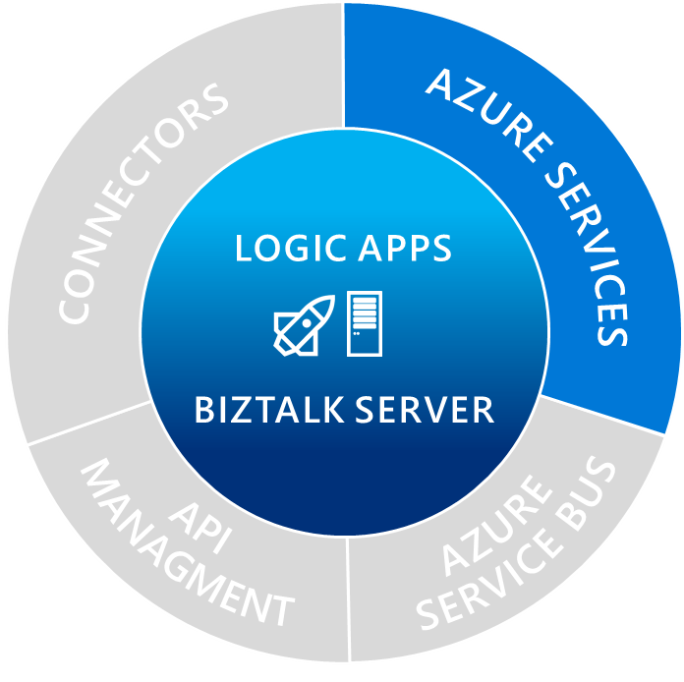




Breadth of Azure services
SQL Database
Azure Machine Learning
API Management
Functions
Site Recovery
DocDB
Azure Service Bus
CONNECTORS
Azure Search
IoT/Event Hub
Cognitive Services
BLOB Storage
AZURE SERVICES
AZURE SERVICE BUS
LOGIC APPS
Functions:
Make composing cloud apps easy
Easily integrate with Logic Apps
BIZTALK
Cognitive
Services:
Sentiment analytics
Language and topic detection
API MANAGMENT
B2B/EDI
Machine
Learning:
Intelligence and proactive management
Analytics that enable action
Notes:
Lets say you want ot run a small piece of code and resuse the results in Logic Apps – use functions
Customer example for cognitive services

Slide 8

True on-premises and cloud connectivity
Microsoft Flow
BizTalk Server
Integrate on-premises LOB to SaaS apps Automate mission critical processes Support for latest Microsoft Platforms
Logic Apps
Serverless compute, auto scaling, fully managed Connect SaaS applications Leverage Azure Services
API Management
Document and catalog LOB APIs Discover, manage and secure connectivity Gain insights, measure and monetize
Service Bus
Serverless compute, auto scaling, fully managed Publish & Subscribe, Topics and Queues Secure and predictable message delivery
Microsoft Pro Integration Team
Notes:
Quick overview of products:
Need governance of APIs across on-premises and cloud applications.
The evolution of hybrid integration platform (HIP) approaches creates requirements and opportunities for converging application and data integration. Characteristics of HIP-enabling technologies include interdisciplinary integration patterns, cloud/hybrid enablement, and diversity of user personas (spanning integration specialists to citizen integrators). This technology evolution will drive inherent synergies between data and application integration as a unified and pervasive set of disciplines (see "Modernizing Integration Strategies and Infrastructure Primer for 2016" ).

Slide 9
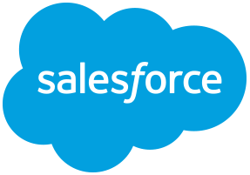
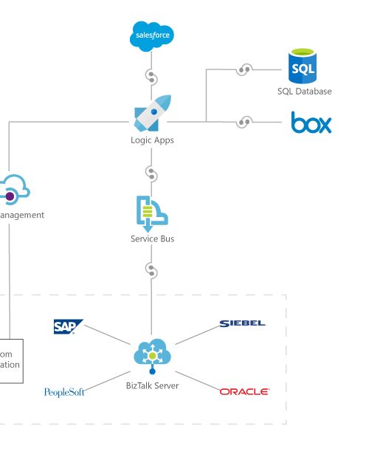







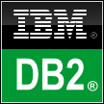


Orchestrate anything
Azure SQL
Microsoft
Dynamics CRM
Connect on-premises, hybrid and cloud applications
Run mission-critical, complex integration scenarios with ease
Enhance business productivity by automating business processes
Easily connect custom on-premises applications to the cloud
Coming Soon
SAP and FILE
Logic Apps
API app
On premises data gateway
Web app
SAP
FILE
SQL Server
BizTalk Server

Slide 10
Azure Logic Apps
Create business processes and workflows visually
Integrate with SaaS and enterprise applications
Unlock value across on-premises and cloud
Automate EAI, B2B/EDI, and business processes
Leverage Integration Platform as a Service (iPaaS)
Transform workflows into intelligent actions
Notes:
Create business processes and workflows visually
Use simple intuitive tools that allow you to rapidly create workflows bringing value to the business faster.
Utilize dozens of pre-built templates that help you get started, help you understand patterns, or inspire you to see new ways to integrate services.
Integrate with SaaS and Enterprise applications
Access the data that you need for your business processes in the place that they live. That data can live in a cloud data store like dropbox, onedrive or in an enterprise management system like Salesforce or Dynamics.
Better together allows you to use Azure services.
Unlock value across on-premises and cloud
Logic Apps allows you to each into your on-premises Line of Business systems through the newly released on-premises data gateway.
Also allows for utilizing BizTalk Server through the BizTalk connector
Automate EAI, B2B/EDI and business processes
With the Enterprise integration pack we have provided the capability to manage your messaging collateral, manage trading partners and agreements
Leverage integration platform as a service (iPaaS)
Remove the worry of hosting

Slide 11
Message Handling
Flexibility in content types
Flexible content, binary, JSON, XML, primitives
Schema support for JSON schema and XSD
Mapping
XSLT-based – use existing assets
Visual Studio mapper to create xslt-based maps
Parameters support*
Validation
Check for errors in selected schema
Flatfile
Convert to/from flatfile – csv, delimited, positional
Built-in type conversion json<>xml<>base64
Flexible processing
Decoupled messaging from processing
Ability to send data to a batch*
Release on specific criteria e.g. size/time
Group by user-defined data (partitioning)
Or use Flush action to release batch immediately
EDI
Outbound encoders, X12, EDIFACT will make use of batching for B2B
Out of box X12 and EDIFACT schema
Leverage batching capabilities

Slide 12
Enterprise Messaging
Validate
Extract
Transform
Enrich
Route
XML Validation
@xpath
XSL Transform
Compose
Send message to topic
VETER Pipeline
Reference schema in Integration Account
Select literals, single nodes or node-sets
BizTalk mapper compatibility
Parameter support (enrich)
Construct a new message

Slide 13
Integration Account
Schemas
Maps
Trading Partners
Agreements
Certificates (KeyVault integration)
Extensible
Store your own configuration
Easy to manage
REST API, PowerShell, Portal, Visual Studio
Secure, scalable, manageable
Schemas
Maps
TPM
Custom
Config

Slide 14
Integration Account Pricing
Integration Account
AUD $1,273.70 / month
Enterprise Connection
AUD $1,018.96 / month
Dev/Test Rates Available (50%)*
Pay-As-You-Go Dev/Test
Enterprise Dev/Test
Free Tier for Development
1 Integration Account per region
10 agreements
25 maps
Schemas
Maps
TPM
Custom
Config

Slide 15
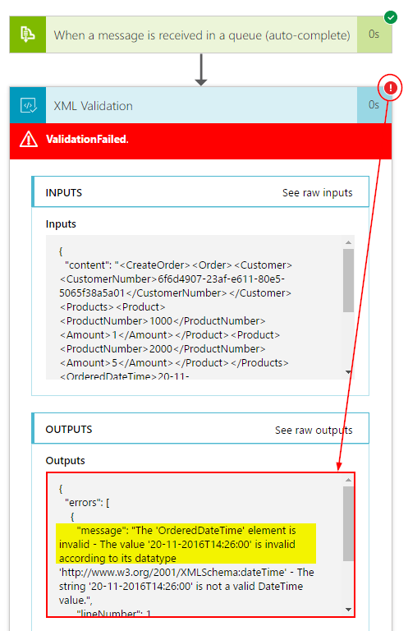
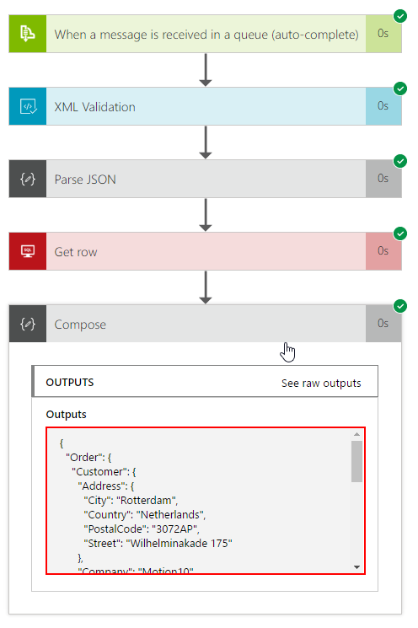
Debugging and History
Trigger history
Run history
Monitoring view
Diagnostics & Alerts
Azure

Slide 16
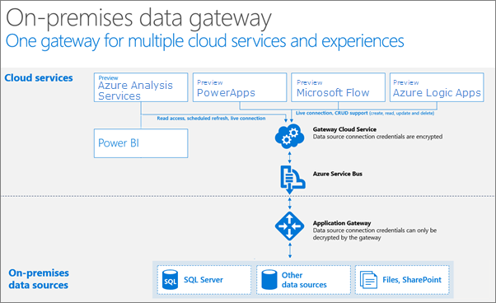
On-Premises Data Gateway
Secure data transfer between on-prem resources and Azure
No inbound firewall rules required
Runs as a Windows service on-prem
Cloud resources supported:
Logic Apps
Power Apps
Microsoft Flow
PowerBI
Azure Analysis Services

Slide 17
On-Premises Data Gateway
On-prem resources supported:
BizTalk Server
DB2
File System
Informix
MQ
Oracle Database
SAP Application Server
SAP Message Server
SQL Server
Notes:
Constraints:
Needs a 64-bit Windows Server (Windows 7 / Windows Server 2008 R2)+
Cannot be installed on a domain controller.
Only one gateway can be installed on a single computer.
Should be a machine that is always on
Wireless connection may reduce performance

Slide 18
Lab #2
Service Bus + Enterprise Integration Pack + On-premises Data Gateway

Slide 19


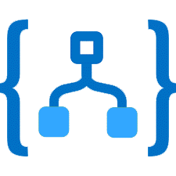


Hands-On Lab
Install and configure On-Premises Data Gateway
Register the On-Premises Data Gateway in Azure
Import the LegacyOrderSystem data in the on-premises SQL Server
Create a schema for validation in Visual Studio 2015
Create an Integration Account
Upload the schema to the Integration Account
Provision a Logic App
Associate the Integration Account with the Logic App
Build Logic App Definition
Test the Solution
Integration Account for
schemas and maps
Receive message
HTTP Request
Azure Service Bus
Logic App
Call to enrich data
On-premises Data Gateway
On-premises SQL Server
Notes:
Build a VETER pipeline

Slide 20
Questions?

